Slide 1


Mini Project on
“ Medicinal leaf name detection using image processing “
Dept. of CS&E ( DATA SCIENCE)
Adichunchanagiri Institute of Technology
Chikkamagaluru - 577102
Presented By,
Krushitha P R (4AI22CD029)
Shalini L S (4AI22CD047)
Spandana H G (4AI22CD053)
Yashaswini M J (4AI22CD063)
Under the Guidance of
Dr. Adarsh M J

Slide 2
Problem Statement
Identifying medicinal leaves accurately is challenging, especially for individuals without botanical expertise. Misidentification can lead to improper use and health risks. This project addresses the need for an efficient and user-friendly solution to identify medicinal leaves, their scientific names, and their uses using image processing .

Slide 3
Scope of the Project
Key Areas the Project Focuses On:
Developing a system to identify medicinal leaves using image processing.
Providing information about the leaf’s scientific name and its medicinal uses.
Storing data for future references in a MongoDB database.
Expected Impact or Benefits:
Helps promote the correct use of medicinal plants.
Simplifies leaf identification for herbal medicine practitioners, researchers, and enthusiasts.
Enhances awareness of medicinal plant applications.

Slide 4
Project Design
Components Involved:
Hardware: Camera or smartphone for capturing images, computer for processing.
Software: Python (OpenCV, NumPy)and flask for backend, HTML, CSS for frontend, MongoDB for database, Visual Studio Code for development.
System Design or Block Diagram: Include a flowchart or block diagram representing:
Image acquisition → Preprocessing → Feature extraction → Database matching → Display results.

Slide 5
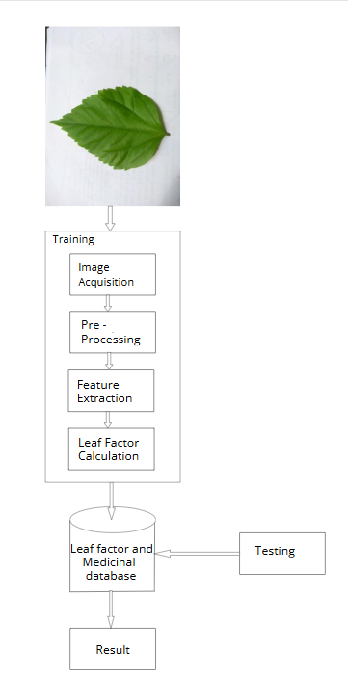
System Architecture

Slide 6
Methodology
Steps or Approach Followed:
Capturing or selecting an image of a medicinal leaf from the dataset.
2.Extracting features using image processing techniques.
3.Matching features with the MongoDB database.
4.Displaying the leaf name, scientific name, and medicinal uses.
Tools and Technologies Used:
OpenCV: For image processing.
NumPy: For numerical computations.
Flask: To build the user interface.
MongoDB: For storing leaf metadata.

Slide 7
Implementation
Highlights of the Code and Database Design:
Python script to process images and extract features.
Flask-based web interface to upload images and display results.
MongoDB database schema for storing:
Leaf Name
Scientific Name
Features
Medicinal Uses
Screenshots or Snippets:
Preprocessed image examples.
Python code snippets for feature extraction.
Database schema visualization.
Flask interface screenshot (upload page and output display).

Slide 8
Results
Output or Outcomes Achieved:
Accurate identification of medicinal leaves.
Display of information including name, scientific name, and uses.
Organized and accessible database of medicinal plant information.
Screenshots:
Accuracy comparison (predicted vs actual leaf names).
Screenshots of the output interface.

Slide 9
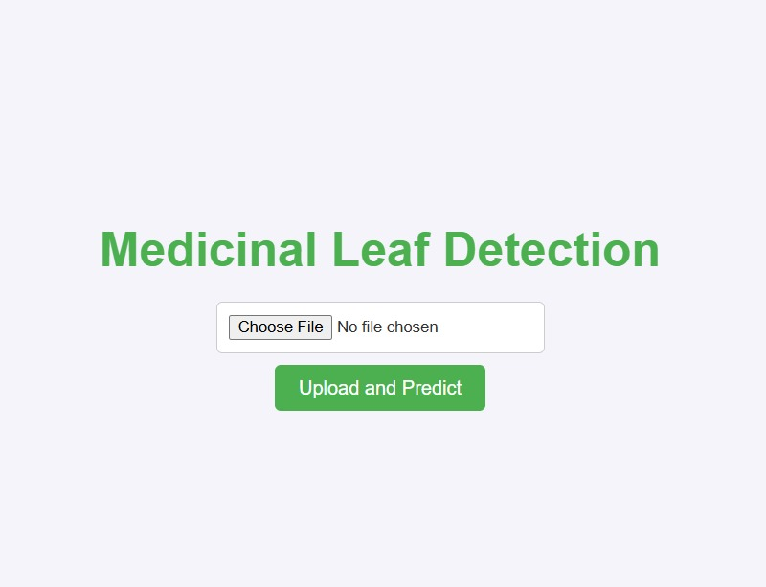
Result Snapshots

Slide 10
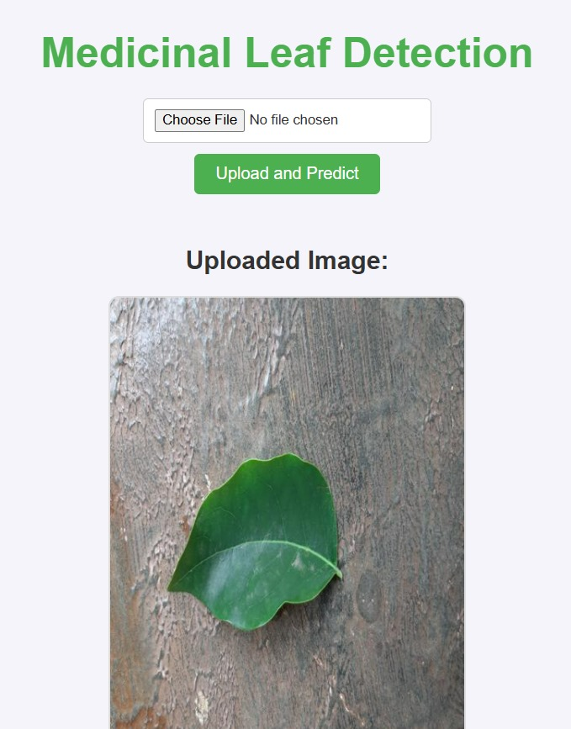
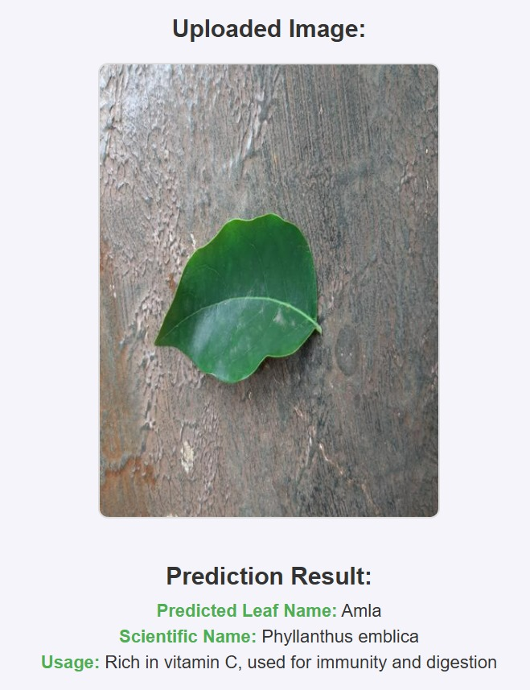
Result Snapshots

Slide 11
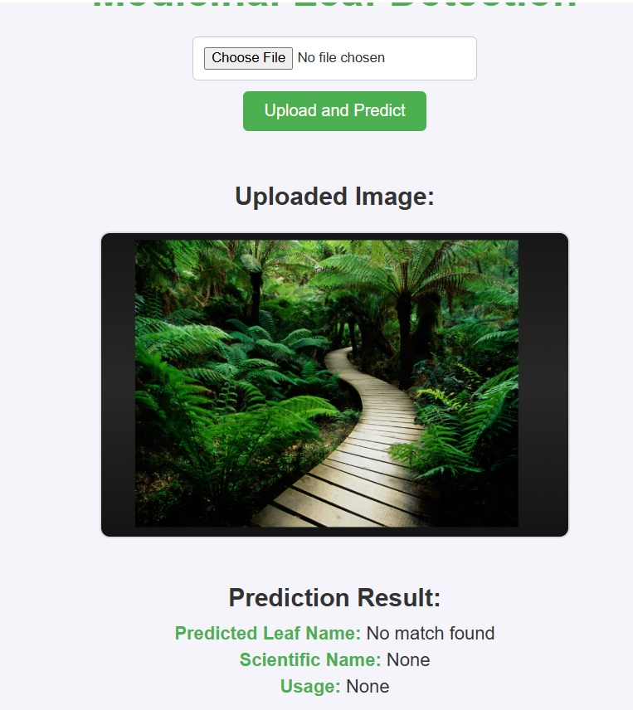
Result Snapshot

Slide 12
Challenges Faced
Issues Encountered:
Dataset preparation (selecting appropriate images and labeling).
Feature extraction accuracy for leaves with similar shapes.
Integration of the MongoDB database with the Flask app.
How They Were Resolved:
Used a curated Kaggle dataset for better results.
Applied image preprocessing techniques (noise removal and edge detection).
Followed Flask-MongoDB integration tutorials and optimized queries.

Slide 13
Future Work
Enhance the database by adding more medicinal leaf and uses.
Improve the feature extraction method for better accuracy.
Extend the system to detect diseases in medicinal leaves.
Develop a mobile app version of the system for better accessibility.

Slide 14
Conclusion
Summarize the project’s achievements, impact, and learning outcomes: This project successfully developed an efficient system for identifying medicinal leaves and providing essential information about their uses. It promotes the safe and effective use of medicinal plants while fostering interest in traditional medicine.

Slide 15
GitHub Link
https://github.com/SpandanaHG/Medicinal-leaf-name-detection
https://github.com/Yashaswini1319/Medicinal-leaf-name-detection
https://github.com/krushithapr/medicinal-leaf-name-detection-using-image-processing
https://github.com/shalini-ls/medicinal-leaf-name-detection.git

Slide 16
THANK YOU

